Slide 1

A Practical Introduction to Artificial Intelligence, Machine Learning, Python, & TensorFlow
Tony Held Python User’s Group Monthly Meeting April 30, 2024

Slide 2
Presentation Overview
Key AI/ML terminology
Compare contrast of traditional programming to machine learning
ML architecture and practical/intuitive introductions to nueral networks
Python/TensorFlow/Colab code walkthrough to show how to evaluate air quality data with ML frameworks

Slide 3
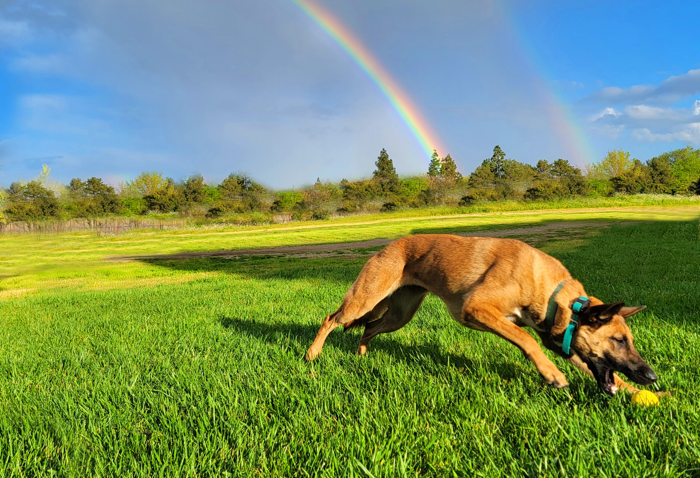

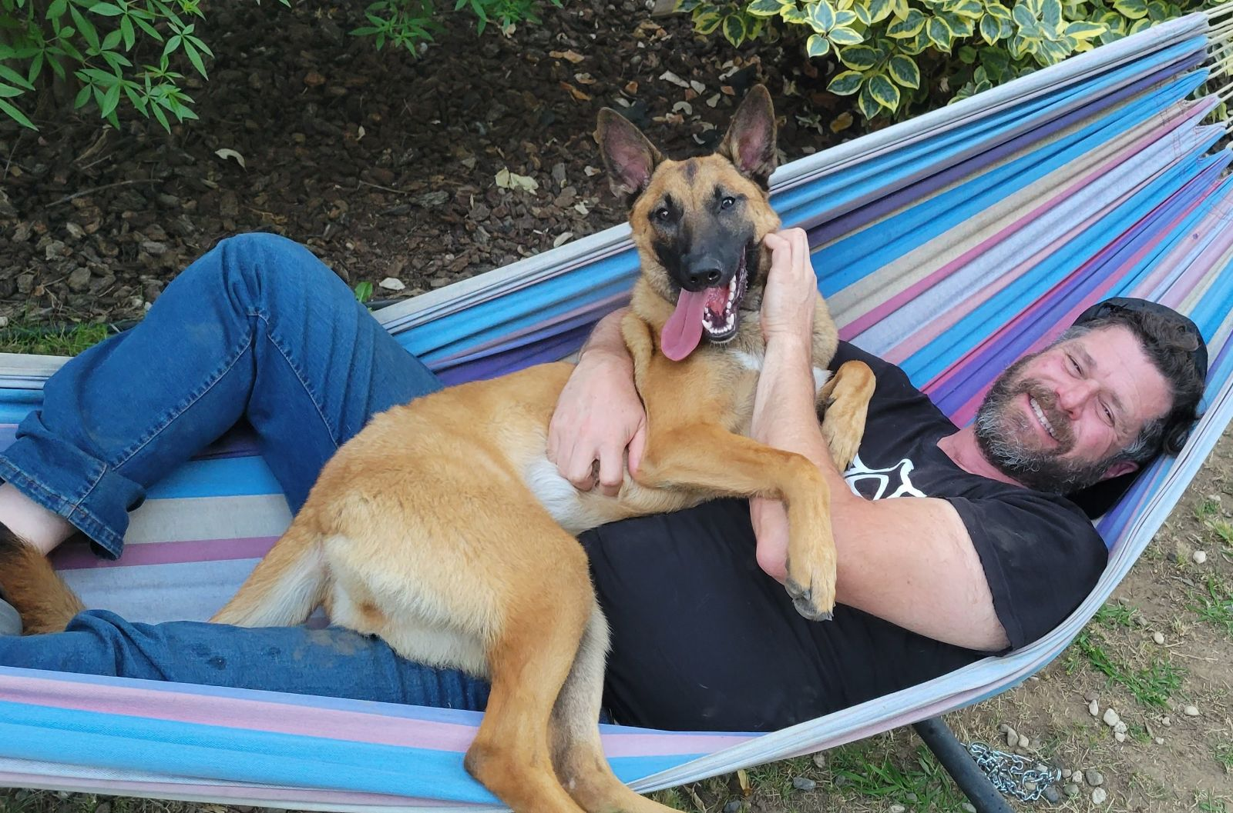
About Me & Peanut
One of us:
Belgian Malinois Rescue
About a 1.5 years old
65 pounds of squirrel chasing fury!
One of us:
Grew up in California, Texas, Washington DC, & Hawaii
Learned to program when I was in 5th grade when my dad took a computer science night school class
Undergrad at Univ. of Texas, Austin
Grad school and postdoc at UC, Davis.
Dissertation was the creation of a new roadway dispersion model (in a new language called Java)
Postdoc was photochemical grid modeling of the San Joaquin Valley
Joined CARB in Oct, 2023 in the Remote Sensing Data Analysis Section (RSDAS)

Slide 4
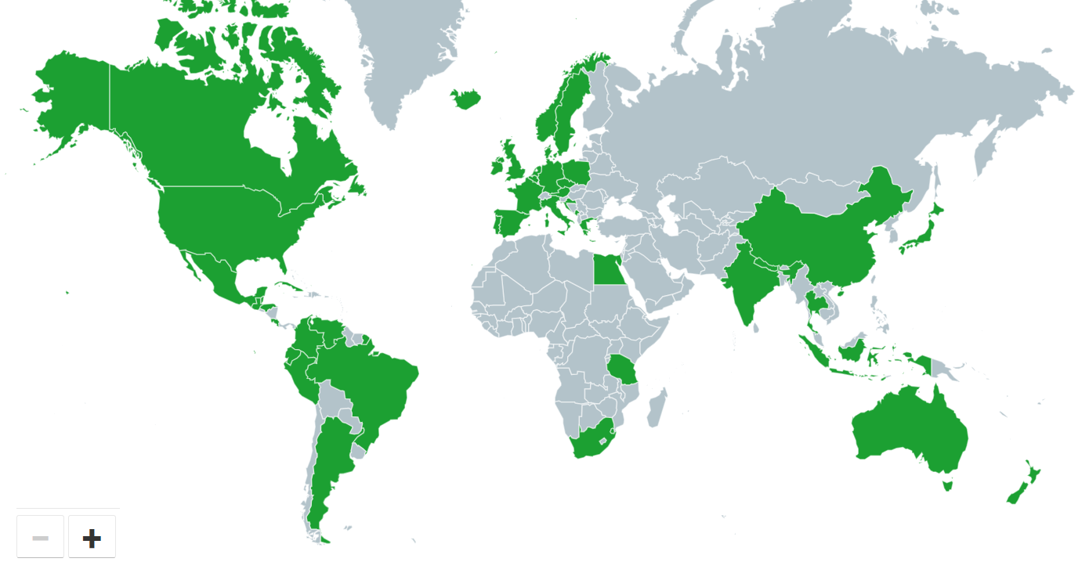

Slide 5
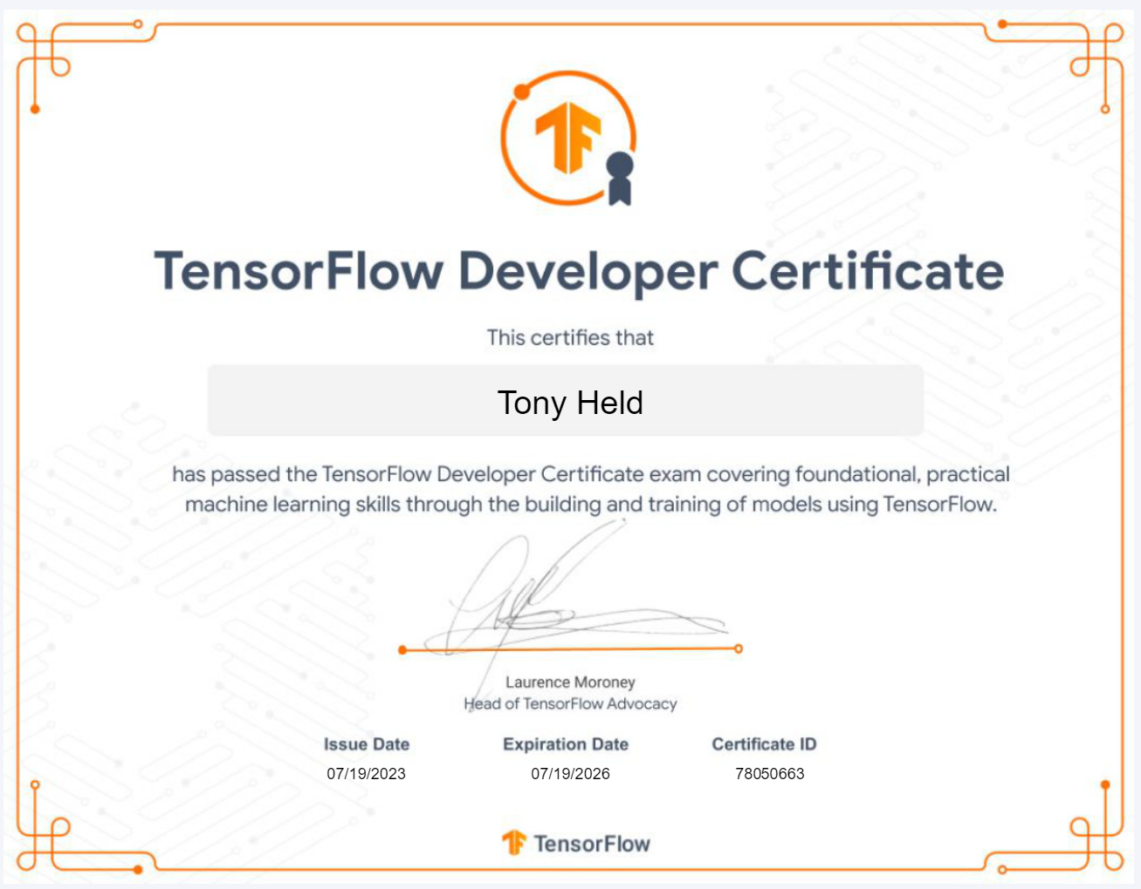
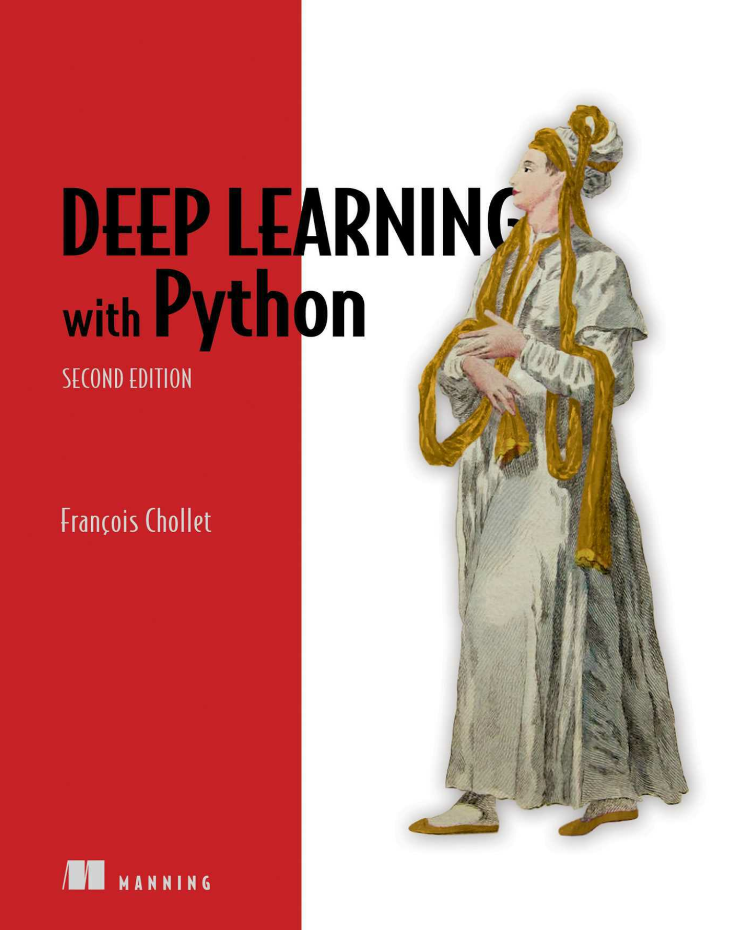
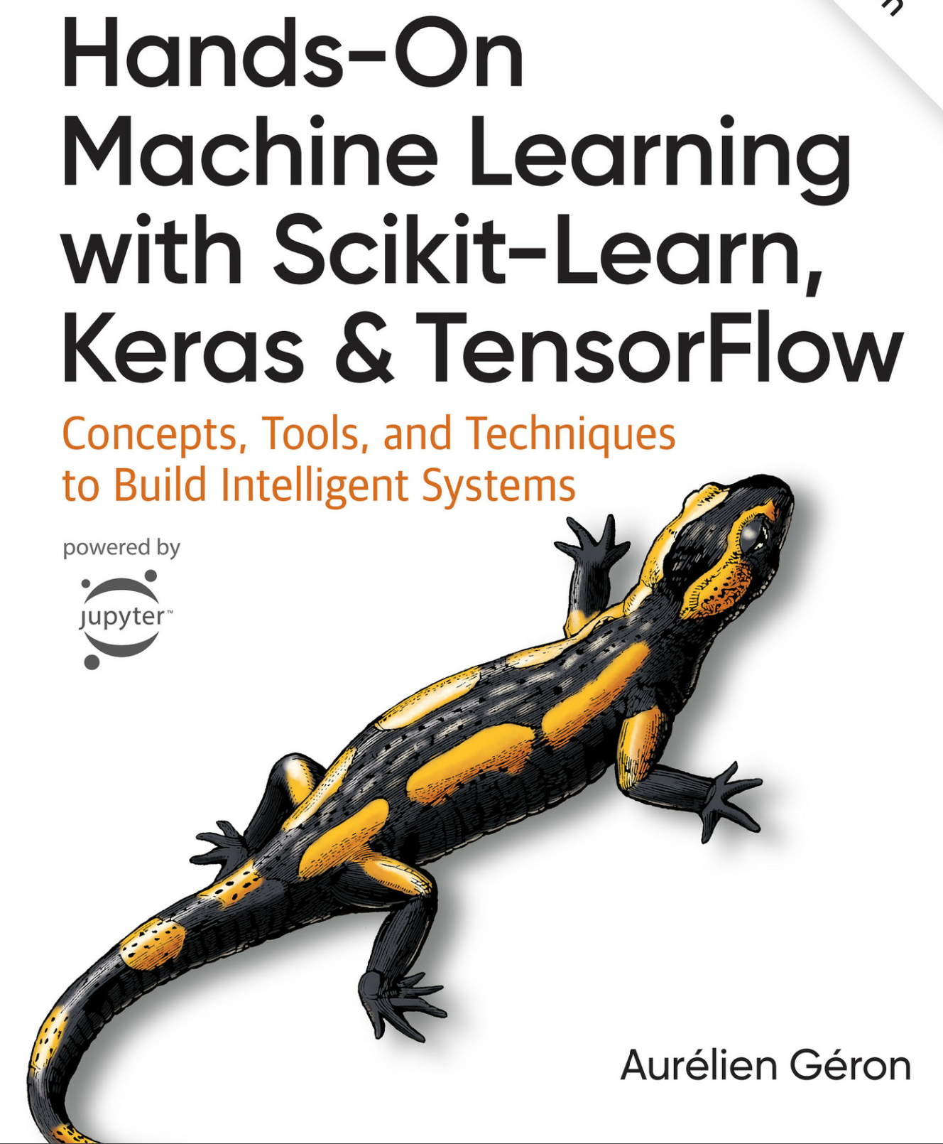
My Machine Learning Training
Notes:
Only around 500 or so are TF certified in the North Americas

Slide 6
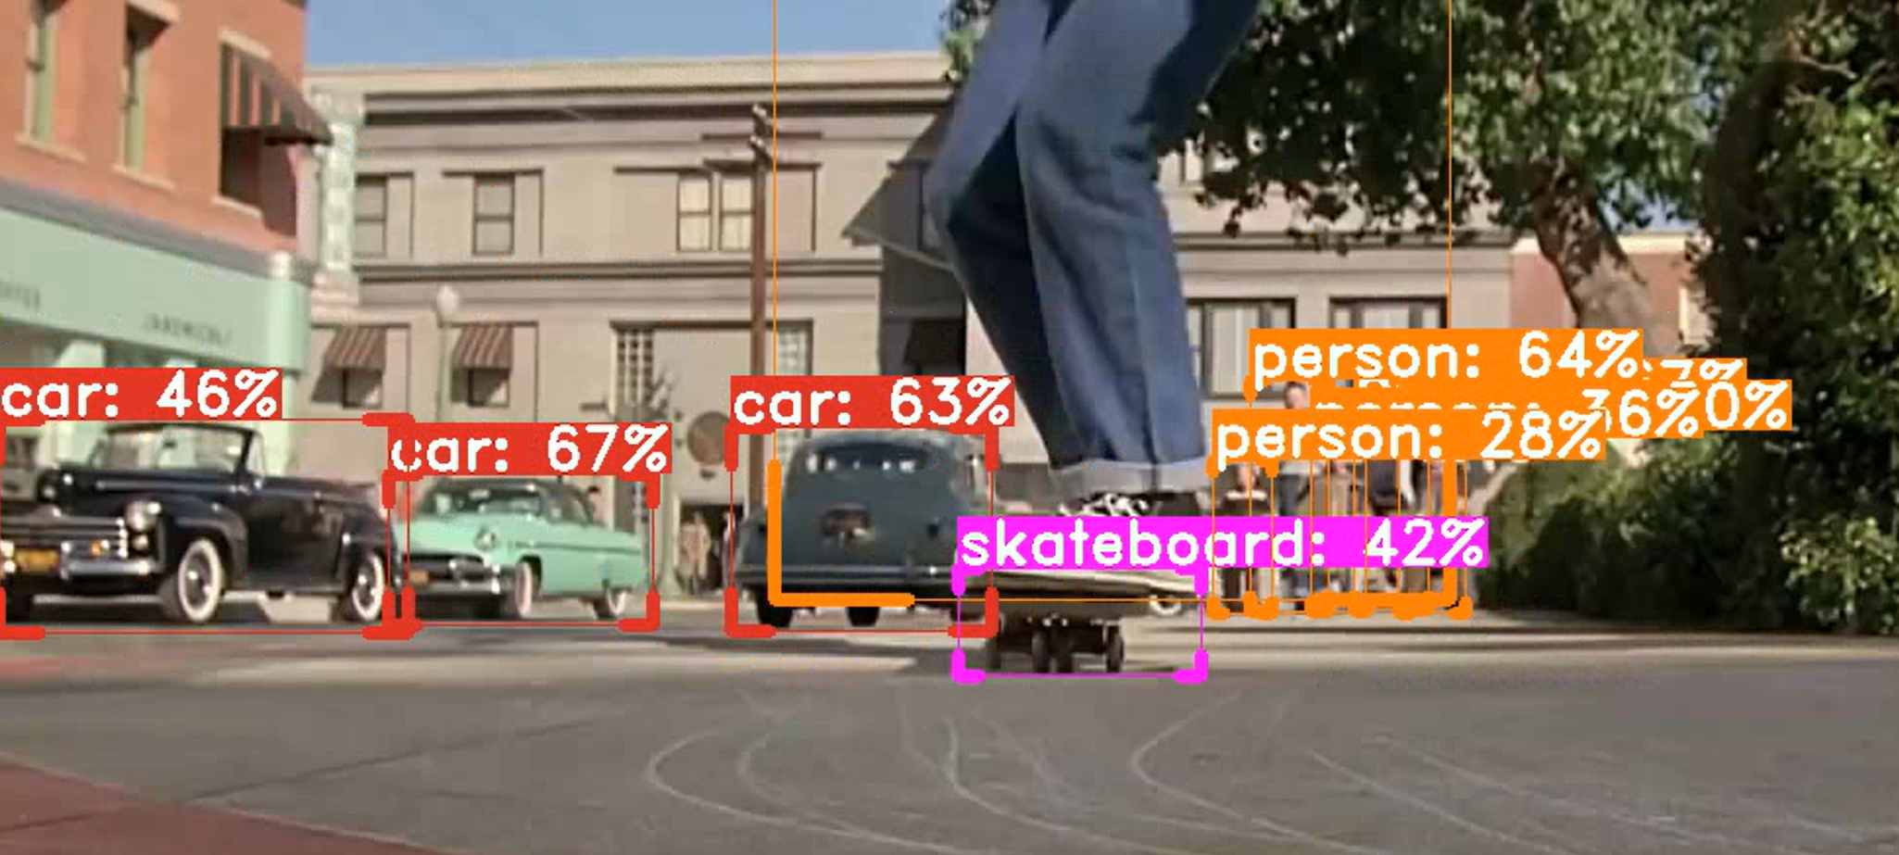
Example Video Processing Project
Play object detection and classification video

Slide 7
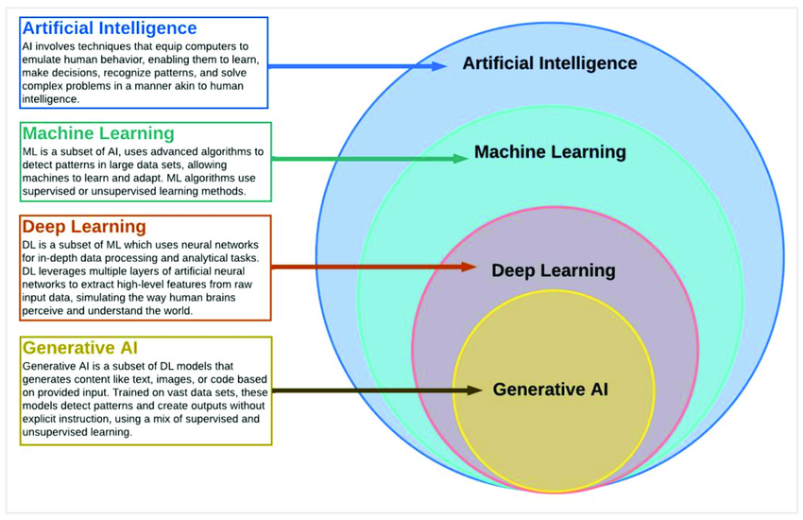
AI, ML, Deep Learning Defined

Slide 8
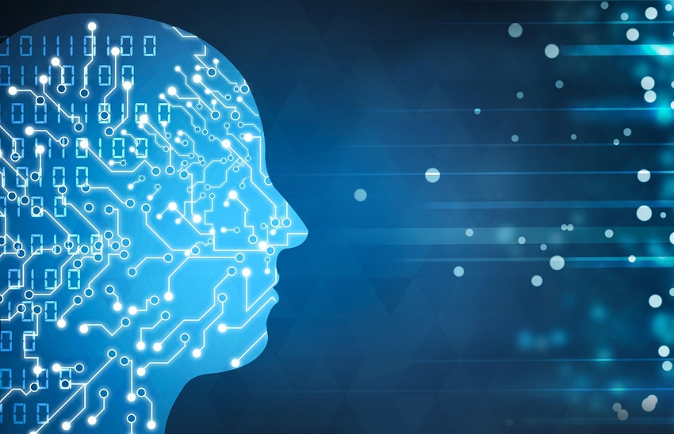
AI
Anything that emulates human like behavior
Could be a Fortran program with millions of if statements designed to play chess
Sometimes used interchangeably with ML/DL, but does not have to be ML/DL
It is the superset of anything related to the field

Slide 9
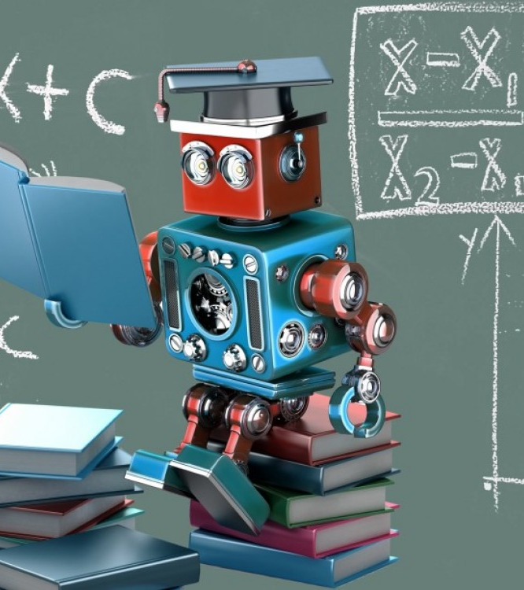
ML
A subset of AI
A very different paradigm of how to develop software than traditional programming
Requires lots of example data
In traditional programing you have to define rules and logic, in ML you define an architecture of parameters (model) and then you tune the parameters (training) to result a way to make future predictions
Spam detection was one an excellent early use case of ML

Slide 10
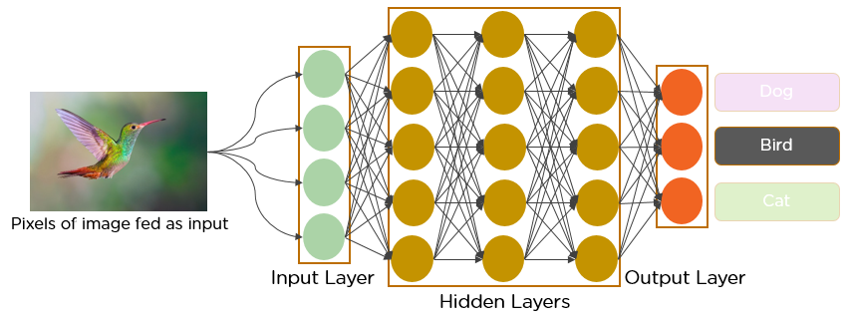
Deep Learning (DL)
A specific type of ML architecture
Also referred to as Neural Networks

Slide 11

Generative AI
Generative artificial intelligence is artificial intelligence capable of generating text, images, videos, or other data using generative models, often in response to prompts.
Generative AI models learn the patterns and structure of their input training data and then generate new data that has similar characteristics.
Examples include ChatGPT and other Large Language Models (LLMs)

Slide 12
ML – Common Usage Scenarios
Classification
Your answer is a category or yes/no.
Is this an image of a pizza or steak?
Does this image have an animal? If so, what species?
Regression
Your answer is usually a continuous number.
Given housing details, what will the house sell for?
Time Series Analysis
What will be the temperature tomorrow based on the last 30 days weather?
Natural Language Programming (NLP)
Spam detection
ChatGPT

Slide 13
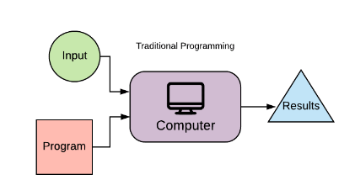
Traditional Programming
The program contains the business/scientific logic and is designed by scratch by an individual
The computer follows if/then statements and make a prediction

Slide 14
Machine Learning
The researcher defines:
Model architecture (what parameters and how they connect)
How parameters are updated
How many times the same input data is fed into the model
The process of adjusting the model parameters is called training or learning
Once you have a trained model, you can evaluate its performance on input data it has not seen before
Input
Model
Model Output
Compare Real vs. Modeled Output
Adjust Parameters
Repeat till Satisfied

Slide 15
Practical Example – Estimating Future Height
Features |  |  |  |  |  | Labels
Height | Weight | Foot Length | Blood Type | Country |  | Height
age 2 |  |  |  |  |  | age 21
39 | 30 | 5 | O | USA |  | 60
33 | 29 | 5 | A- | Mexico |  | 61
33 | 27 | 4 | B+ | Canada |  | 63
34 | 24 | 7 | A+ | Costa Rica |  | 75
36 | 24 | 6 | B- | Brazil |  | 68
32 | 24 | 4 | AB- | China |  | 66
33 | 30 | 5 | AB+ | England |  | 75
34 | 27 | 6 | O | Ireland |  | 56

Slide 16
Traditional Programming
Make scientific hypotheses about how the input features relate to the target (label).
Perhaps do statistical analysis, use journal findings, etc
Perhaps write a program that says:
If from Country A then use formula 1
If from another Country B then use formula 2
Measure the goodness of fit between your modeled output and the real output.
If you don’t get good results, change your business logic

Slide 17
A Machine Learning Approach
Define
Define model architecture
Select the number of parameters and how they interrelate
Determine
Determine what modeling error metric you are trying to minimize
e.g. reducing mean average error or mean squared error
Split
Split the data into training and testing subsets
Typically, 80% for training and 20% for testing
Select
Select the number of epochs (times the entire dataset are input into the model)
Train
Train the model by letting it adjust the model parameters to reduce error
Evaluate
Evaluate model performance on test data
Try
You can try lots of different model structures and sizes and see which performs best for your data

Slide 18
One node (neuron) model
Training. Keep looping over the input data until parameters m1 and b1 are found to minimize error between model output and actual y
Testing. Use the m1 and b1 determined in training to evaluate model performance on data not included in the training set.
Input, x1 (height at 2 years old)
m1, b1
Output, y (height at 21 years old)

Slide 19
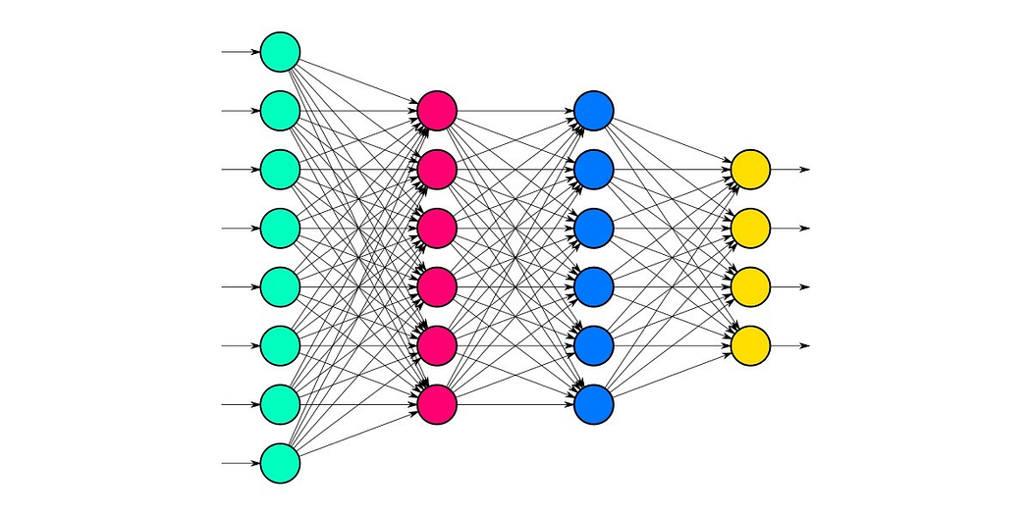
Deep Dense Network

Slide 20
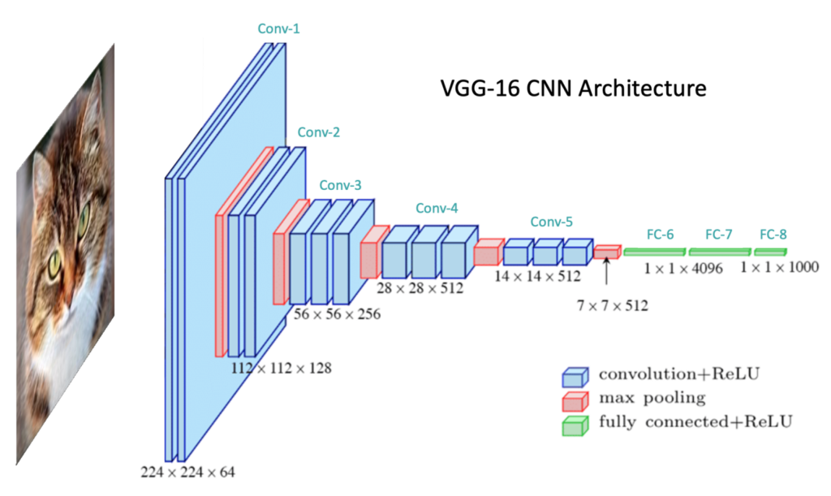
CNN Networks
Some architectures work well for certain problem types. CNN’s are effective for image processing
In image processing, each pixel color intensity is input to a model architecture similar to the right to perform image classification
Finding the optimal architecture is an art, as an early practitioner, simply look up which architecture works best for your problem type

Slide 21
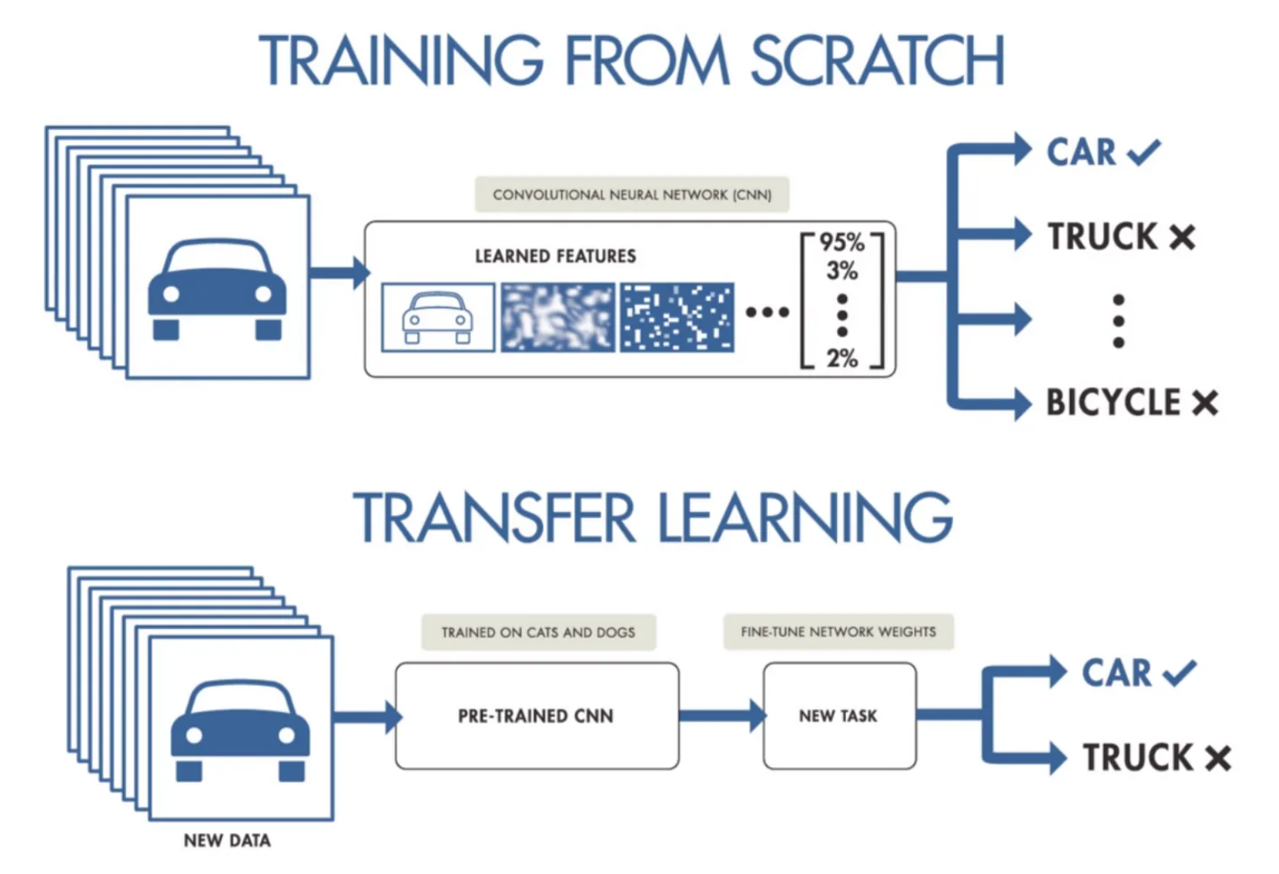
Transfer Learning
Pre-trained models can work surprisingly well for new purposes.
There are a variety of free pre-trained models that you can use without the need for additional training or data
TensorFlow Hub (https://www.tensorflow.org/hub) is one such repository where you describe your modeling needs and you can pick and choose which pre-trained model to try out on your data
Usually there is a compromise between model size and performance

Slide 22
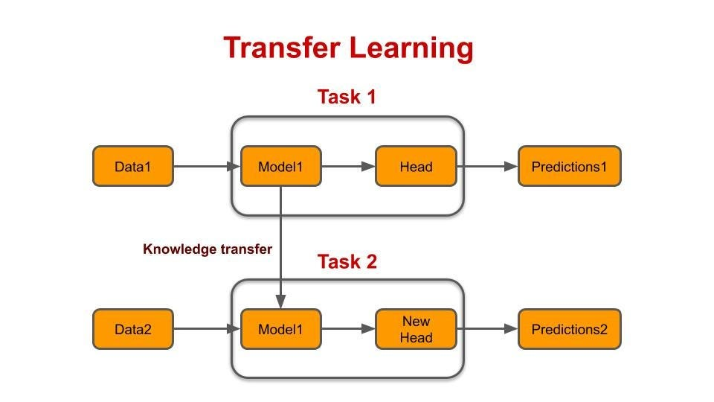
Fine Tuning
You don’t have to develop models from scratch, you can extend existing models that have proven performance and adapt them to your new purpose
Consider you want to have a model determine the species of rare birds, and that no model has been trained with rare birds before
You can take a pre-trained model that was trained to detect general animals and then fine-tune that model so that perform the new purpose … it works amazingly well

Slide 23
Let’s get coding!
It can be very tricky to set up your environment for all the machine learning libraries to work together
Google offers a free service called Colab that allows you to run a jupyter notebook on the google cloud and thy ensure the environment works
Use Colab to get started!
TensorFlow is an amazing library to allow for quick ML model development that is supported by Google
All files can be downloaded from: https://github.com/tony-held-carb/carb_python_tensorflow_seminar

Slide 24

In Closing
Thanks for your time and attention
Happy for any teaming opportunities that come up

